Slide 1
English 8-Chapter 8
Exercise 7
Combining Sentences by Forming A Compound Sentence

Slide 2
1
The metric system was developed in France. It became popular in many countries.
The metric system was developed in France, but it became popular in many countries.

Slide 3
2
We can keep the old system of measurement. We can switch to the metric system.
We can keep the old system of measurement, or we can switch to the metric system.

Slide 4
3
The old system of measurement has more than twenty basic units of measurement. The metric system has only seven.
The old system of measurement has more than twenty basic units of measurement. The metric system has only seven.

Slide 5
4
A meter equals ten decimeters. A decimeter equals ten centimeters.
A meter equals ten decimeters, and a decimeter equals ten centimeters.

Slide 6
5
Counting by tens is second nature to most people. Many people still find the metric system difficult to learn.
Counting by tens is second nature to most people, but many people still find the metric system difficult to learn.

Slide 7
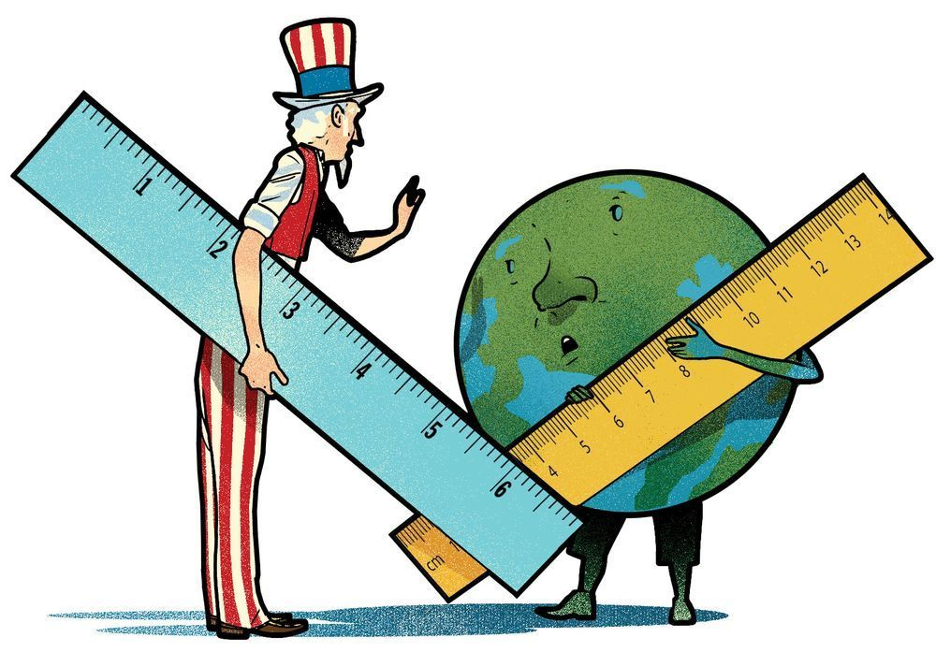
End

